Slide 1
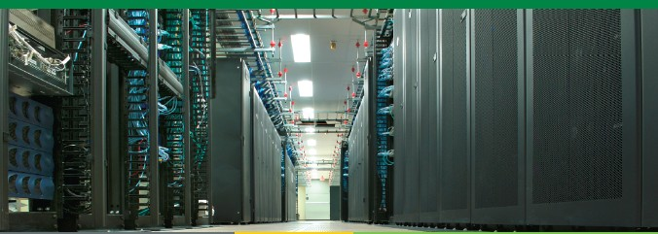
Virtual Batching for Performance Improvement and Energy Efficiency
Dazhao, Cheng
5/3/2012

Slide 2
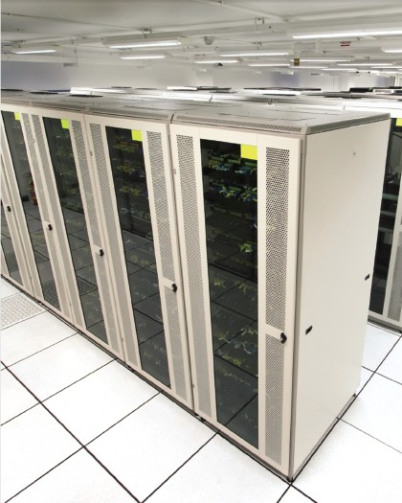
Outline
Introduction and background.
Why we do it?
How we do it?
Technique design of system.
Experiment and evaluation.

Slide 3
Power and performance in Data Center
Application performance
Power consumption
Less hardware resource means less power consumption
But better performance need more resource usage

Slide 4
Why we do batching?
Most Web servers process requests in the order of arrival. (It may lead to low cache hit rate).
Batching requests in a content-aware manner can improve the cache hit rate of Web servers.
It provides the opportunity to improve the performance of multi-tier applications.
Cache
Clients
Requests
Response

Slide 5
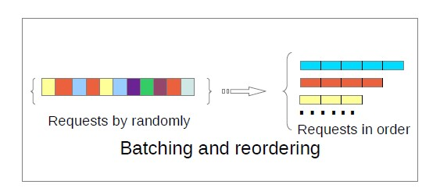
Batching mechanism (batcher)
The main functions of this batcher are:
1.Requests collection;
2.Requests classification;
3.Requests reordering.

Slide 6
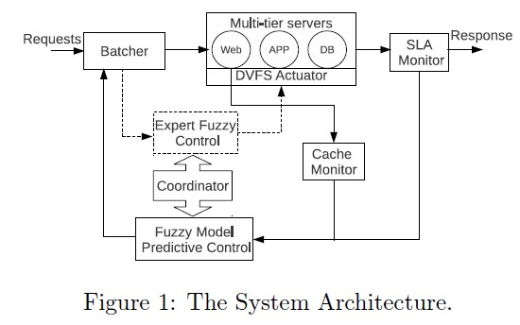
System Architecture
Power control loop
Batching control loop

Slide 7
System Implementation
1) We build a testbed consisting of one server and one client. The server is running CentOS 5.8 with Linux kernel 2.6.18.
2) We use RUBiS as the benchmark application for experiment. RUBiS provides a web auction application that modeled in a similar way of ebay.com.
3) We create three VMs by Xen 3.1, Apache web server in the first, PHP application server in the second, and MYSQL database server in the third.
4) Each VM is allocated 1 VCPU and 512 MB memory. All VMs use Ubuntu server 10.04 with Linux kernel 2.6.35.

Slide 8
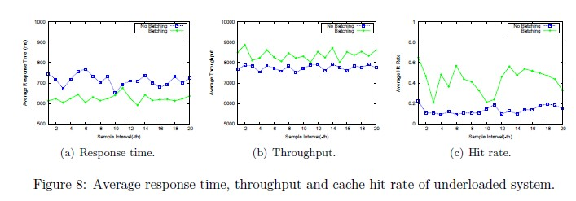
Evaluation
The first scenario is a under-loaded (medium) system:

Slide 9
Evaluation
The second scenario is a slightly overloaded system:
Here we set the SLA of response time requirement is 1000 ms.

Slide 10
Conclusion
1) In this work, we have proposed and developed a content-aware batching mechanism to improve the performance of applications.
2) Its main contributions are the precise control of batching interval length to improve performance and avoid SLA violations.

